Slide 1
Pandas – Advanced Functions
WKSP DSS 220

Slide 2
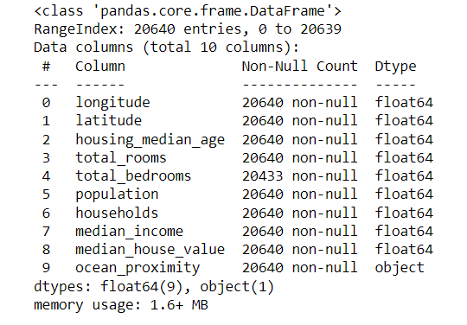
Some Important Functions
df.info()
Type and count of non-Null values for each column

Slide 3
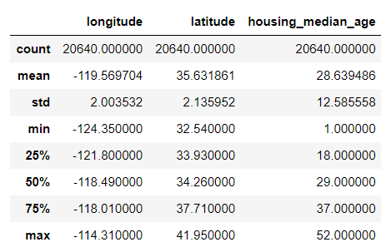
Some Important Functions
df.describe()
Statistical values of each column

Slide 4
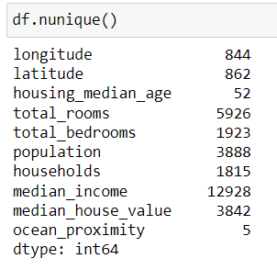
Some Important Functions
df.nunique()
Number of unique values in each column

Slide 5
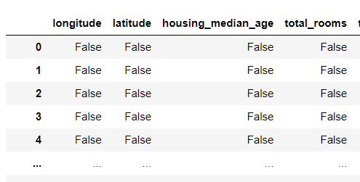
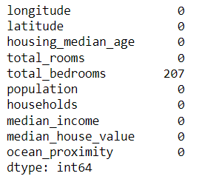
Some Important Functions
df.isnull()
df.isnull().sum() → sum of null rows in each column
df.fillna()

Slide 6
Filtering
df.loc[ : , ‘A’ ] → All rows for column ‘A’

Slide 7
Filtering
df.loc[ : , ‘A’ ] → All rows for column ‘A’
df.loc[ df.loc[ :, ’A’ ] > 40, : ]
1. Find all rows where column A > 40

Slide 8
Filtering
df.loc[ : , ‘A’ ] → All rows for column ‘A’
df.loc[ df.loc[ :, ’A’ ] > 40, : ]
1. Find all rows where column A > 40
2. Return all columns in the data that meet this condition

Slide 9
Sorting
df.sort_values( "housing_median_age")

Slide 10
Sorting
df.sort_values( "housing_median_age", …
ascending = True)

Slide 11
Sorting
df.sort_values( "housing_median_age", …
ascending = True…
inplace = True)

Slide 12
Aggregate Functions
Group data by category
count, max, min, mean, var, std, etc.
Select a column
Apply aggregate function
df.loc[:,"housing_median_age"].mean( )
28.639
1. Select a column
2. Apply aggregate function

Slide 13
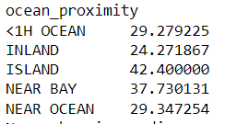
Grouping
Split Data into Groups
Apply aggregate function
df.groupby( [ 'ocean_proximity‘ ] ).mean( )
1. Split Data into Groups
2. Apply aggregate function

Slide 14
Method Chaining
DataFrame
Method
DataFrame
Method
DataFrame
Method
.
.
.

Slide 15
Method Chaining
df2 = df1.loc[: , [‘A’ , ‘B’] ]
Method
df3 = df2.fillna(0)
Method
df4 = df3.head()

Slide 16
Method Chaining
df2 = df1.loc[: , [‘A’ , ‘B’] ]
Method
df3 = df2.fillna(0)
Df1.loc[: , [‘A’,’B’] ].fillna(0).head()
Method
df4 = df3.head()

